Slide 1
Automating Job Description Analysis for Recruiters
Presented By
Abirami Rajamanickam
Date
01/09/2026

Slide 2
Automating Job Description Analysis for Recruiters
Problem Statement:
HR teams spend hours manually reviewing job descriptions.
Identifying required technical and soft skills is time-consuming.
Errors in skill mapping can lead to poor hiring decisions.
Manual review is slow and time consuming

Slide 3
Project Scope
Target Users: HR teams and recruiters.
Developed an AI-powered NLP extraction to analyze job descriptions and extract technical and soft skills for HR teams.
The tool automatically categorizes skills, prioritizes key requirements, and provides structured insights to improve hiring accuracy, workforce planning, and skill-gap analysis.

Slide 4
Project Scope Continuation
Application will categories below skill sets:
Programming Languages
Databases & Data Warehouses
Cloud Platforms
DevOps & CI/CD Tools
ETL & Data Migration Tools
Machine Learning & AI Frameworks
BI & Reporting Tools
SAP Functional & Technical Skills
Soft Skills

Slide 5
Why Rule based NLP and System Architecture?
Why NLP?
High precision, interpretable, no training data
Quicker and provides quicker insights based on the Job description.
System Architecture
Input → NLP → Matcher → Output

Slide 6
Solution Overview
Automatically analyzes job descriptions from PDFs, DOCX, or text.
Extracts and categorizes:
Minimum Qualifications
Technical skills
Soft skills
Tools & technologies
Prioritizes key skills to help recruiters focus on relevant requirements.

Slide 7
Features
Upload or paste job descriptions.
AI automatically identifies skills and tools.
Categorizes skills into technical, soft, cloud, DevOps, ML/AI, and more.
Provides structured insights for quick decision-making.

Slide 8
Benefits
Saves time and reduces manual effort.
Improves accuracy of candidate-job matching.
Supports workforce planning and skill-gap analysis.
Scalable solution for multiple job postings.

Slide 9
How It Works
Input job description (copy-paste or file upload).
NLP engine scans the text and identifies key terms.
Matches terms against a predefined tech stack.
Outputs categorized skills and highlights key requirements.

Slide 10
Tech Stack
AI/NLP engine analyzes text.
Recognizes thousands of technical and soft skills.
Provides results including Minimum Qualifications, Technical Skills, Soft skills and domain specific skillsets

Slide 11
Methodology
Problem Solving Approach:
Rule-Based Skill Extraction, Accurate for specific job categories
Predefined keywords and phrases for each category (Programming Languages, Databases, Cloud, etc.)
Text is processed using NLP (Spacy)
PhraseMatcher identifies skills from the job description
Easy to update and extend with new skills
Transparent and interpretable results
Fast, cost-effective and lightweight approach
Easy to maintain for HR-focused skill extraction
Works well with structured and unstructured job descriptions

Slide 12
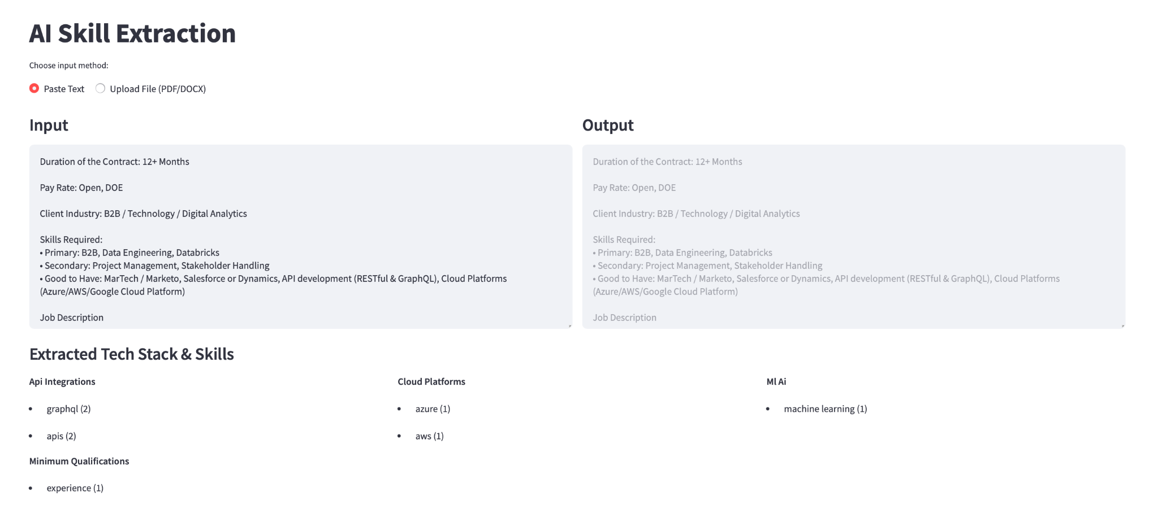
Demo Snapshot

Slide 13
Future Work
BERT NER, matching, dashboards

Slide 14
Any Queries?

Slide 15
Thank you

